Slide 1
Epic Meal Slime:
Playtest Feedback
Rebecca Tester & Matthew Satterfield

Slide 2

High Concept
Help a hungry slime in a big city navigate through pillars and get food by clicking when it’s safe to snack.

Slide 3
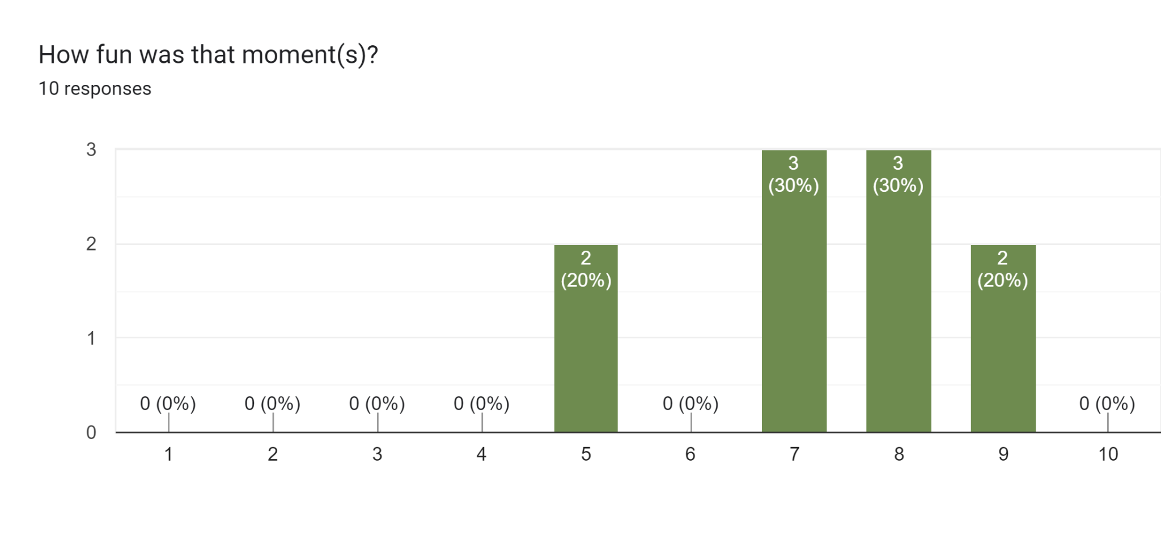
Feedback: Most Fun Moment

Slide 4
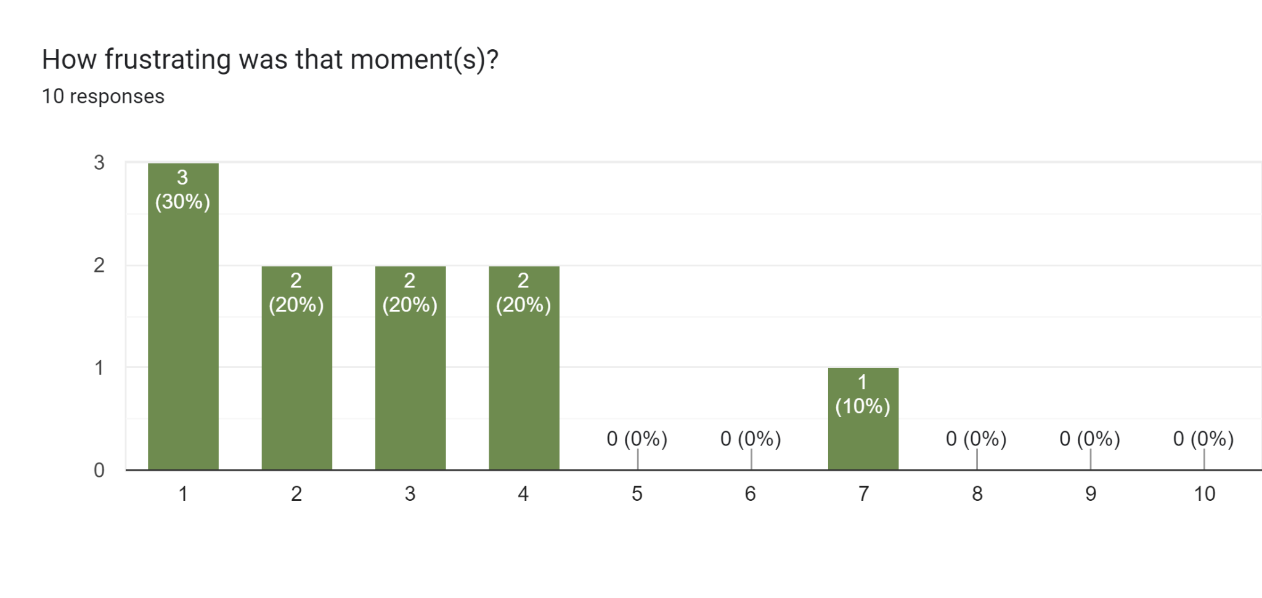
Feedback: Most Frustrating Moment

Slide 5
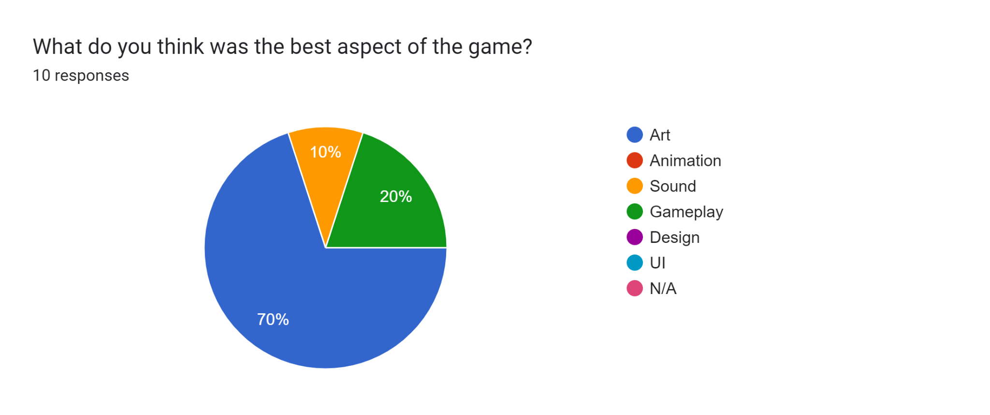
Feedback: Best Aspect

Slide 6
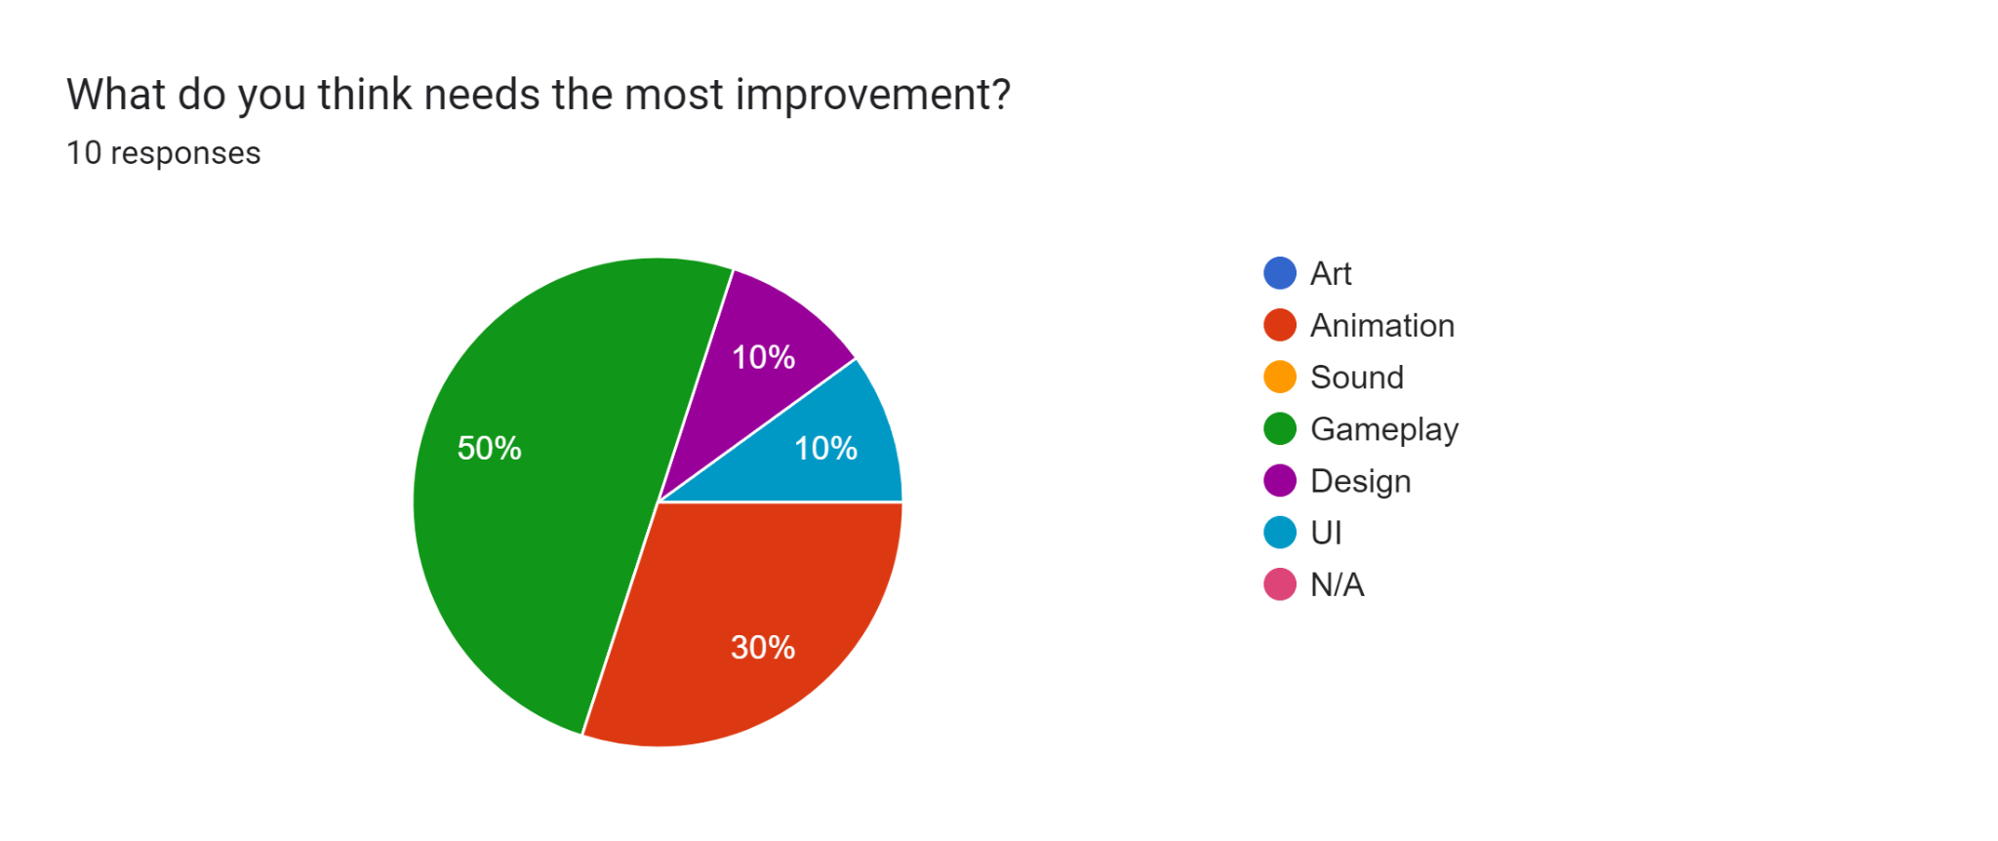
Feedback: Needs Improvement

Slide 7
Misc Feedback
“The pausing was a little confusing when trying to get off it”
“[I would change] maybe the way that the slime moves, make its movements more consistent.”
“Very quick movements that can be confusing to learning how the jump operates”
“The particle effect needs to be more impactful”

Slide 8
Planned Changes
Wall Hit Clarity/Feedback
Additional Visual Liveliness
Quality of Life

Slide 9
Planned Changes (Continued)
Progressive Difficulty
Improved Slime Animation / Additional Squash & Stretch

Slide 10
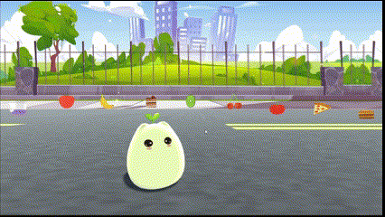
Menu Tweening
The UI elements in all scenes tween in position, rotation, and size onto the screen.

Slide 11
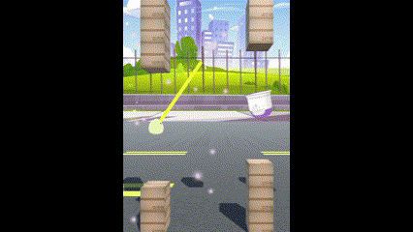
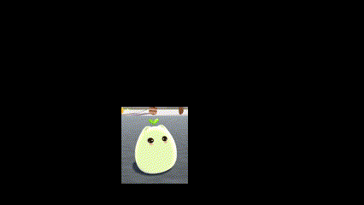
Player Animations
The slime now has an idle and jump animation.

Slide 12
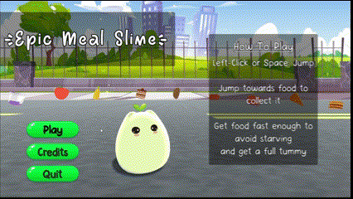
Buttons
The buttons both wobble and grow when you hover over them.

Slide 13
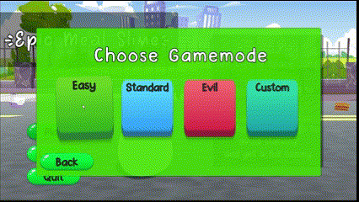
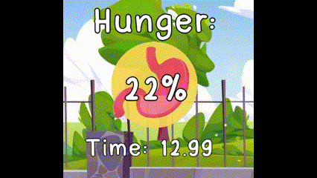
Other
Screen Transitions
Countdown
Reticle wobble
Hunger UI pop

Slide 14
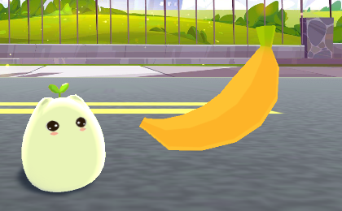
Genre & Theme
Colorful Casual Action
Fantasy and Food
Notes:
Game based off the Omnivore theme

Slide 15

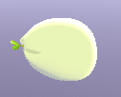
Core Mechanics
Aiming and Jumping through pillars to get food.
Get food to avoid starving.
Get food quickly enough to fill up the slime’s hunger completely and win.

Slide 16
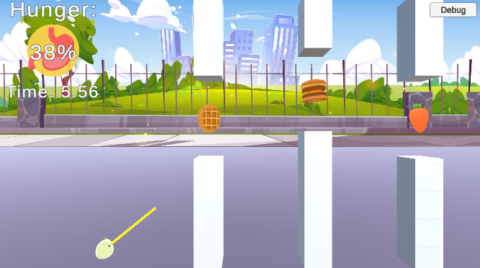
Gameplay
Jumping - Click or press Space.
Aiming - Automatic. Time your jumps.
Hunger - Depletes, but food increases. 0% lose, 100% win.
Notes:
Jumping - Click or press Space to jump and advance to the next pillar
Aiming - An aiming line automatically goes up and down, time your jumps to go through the pillars and get food.
Hunger - Your hunger depletes over time and increases when you get food. Reach 0% and you starve, but reach 100% and you win.

Slide 17

Fun Factor
Trying to beat your best time.
Tension between hunger depleting and aiming.
Easy replayability.

Slide 18
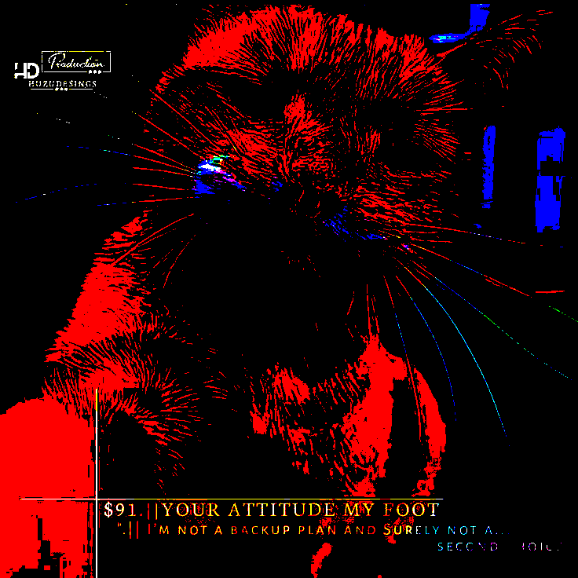
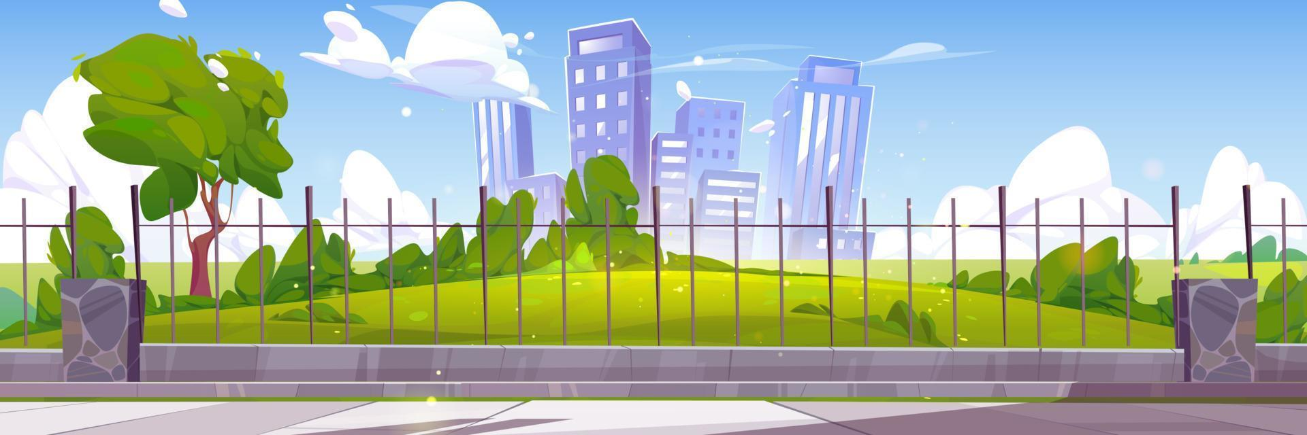
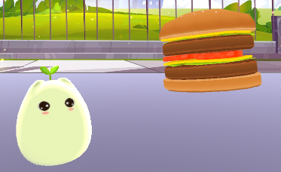
Images in presentation, delete this slide when done

